Slide 1
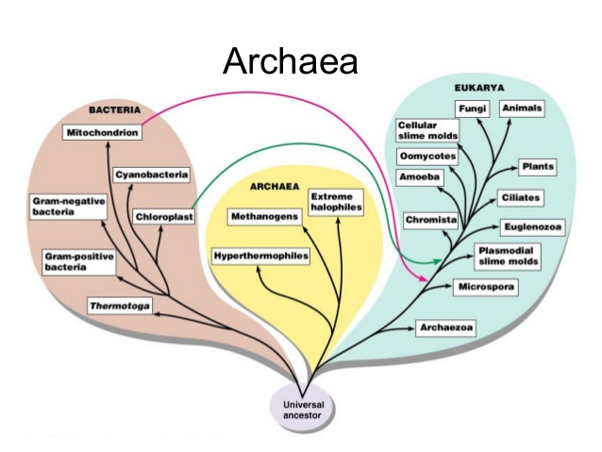
The Diversity of Organisms on this Planet are divided into different Domains

Slide 2
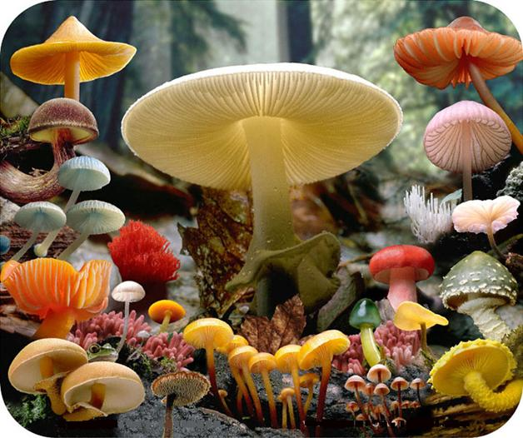
Kingdom Fungi

Slide 3
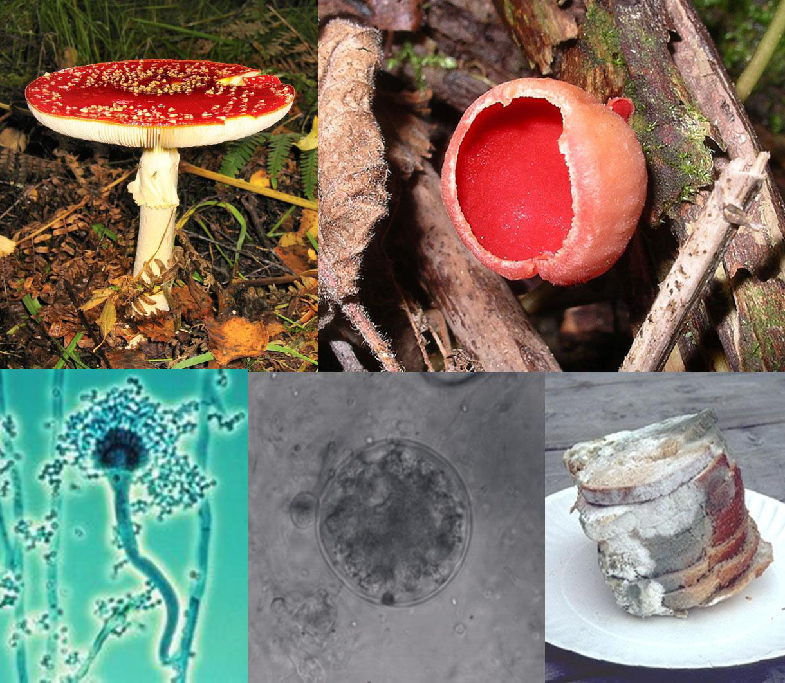
Characteristics of the Kingdom Fungi
Cell wall containing chitin
Cell membrane containing ergosterol
Heterotrophic decomposers, some parasites
External digestion, then absorption
Dispersal to new environments using spores (one cell progeny)
Growth of long thin cells called hyphae

Slide 4
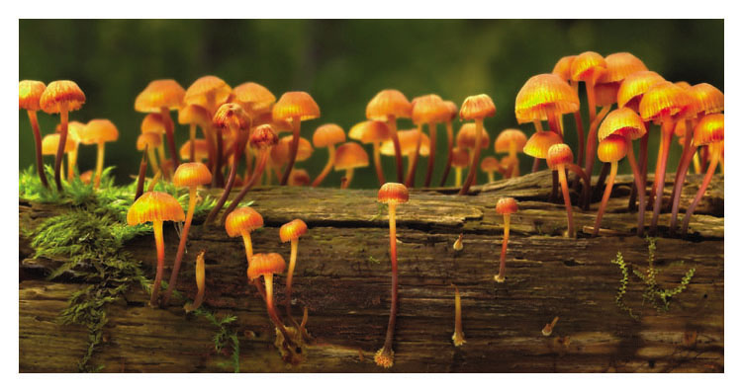
Characteristics of the Kingdom Fungi
Fungi absorb food after digesting it outside their bodies

Slide 5
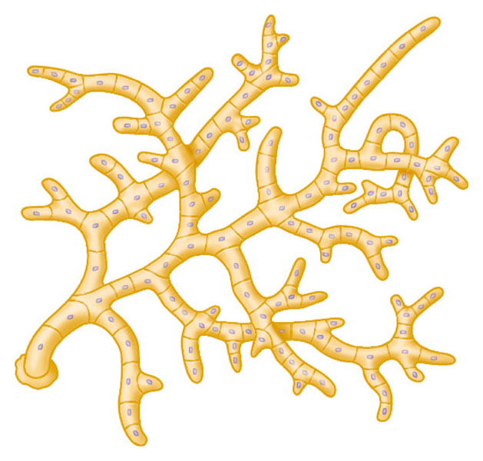
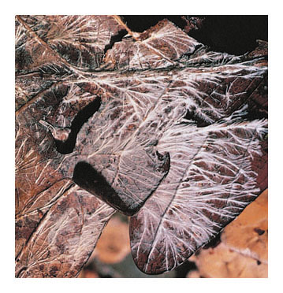
Characteristics of the Kingdom Fungi
A fungus usually consists of a mass of threadlike hyphae
Called a mycelium
Hypha
Mycelium

Slide 6
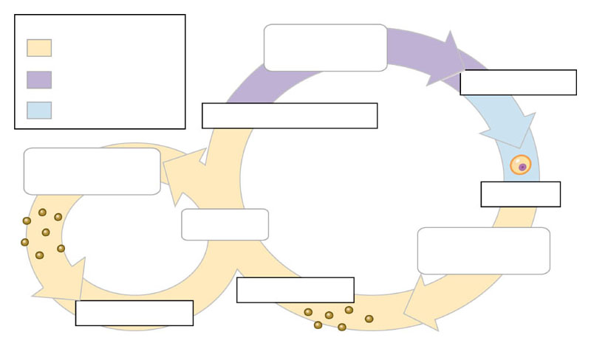
Characteristics of the Kingdom Fungi
Fungi produce spores in both asexual and sexual life cycles
In sexual reproduction,
1 cells fuse, then (often much later resulting in heterokaryotic cells)
2 nuclei fuse and immediately
3 meiosis produces haploid spores
Key
Heterokaryotic
stage
Haploid (n)
Heterokaryotic (n + n)
(unfused nuclei)
Fusion of nuclei
Diploid (2n)
Fusion of cytoplasm
Spore-producing
structures
Zygote
(2n)
Sexual
reproduction
Meiosis
Spores
(n)
Asexual
reproduction
Mycelium
Spore-producing
structures
Germination
Germination
Spores (n)

Slide 7
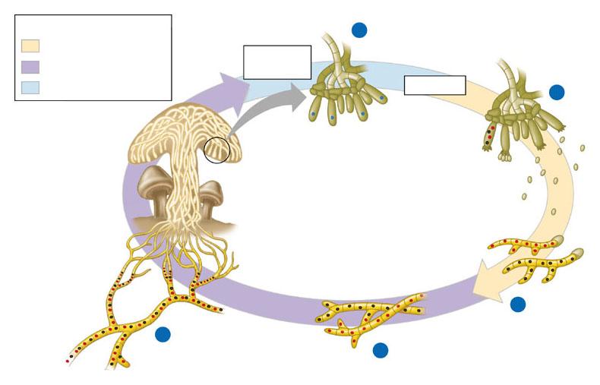
Characteristics of the Kingdom Fungi
Fungal groups have characteristic reproductive structures
Key
3
Diploid nuclei
Haploid (n)
Fusion of
nuclei
Heterokaryotic (n + n)
Diploid (2n)
Meiosis
4
Spores
released
Basidia
Spores (n)
Mushroom
5
Germination of spores
and growth of mycelia
2
Growth of
heterokaryotic mycelium
1
Fusion of two hyphae
of different mating types

Slide 8
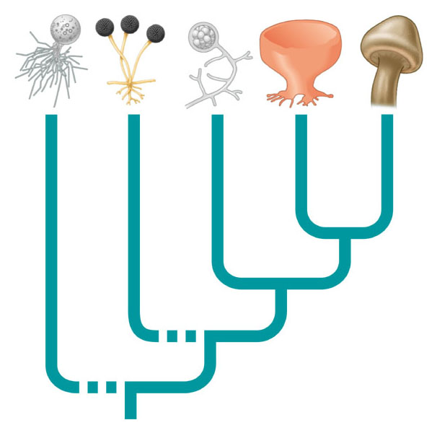
Fungi can be classified into five groups
Chytridiomycota
Zygomycota
Glomeromycota
Ascomycota
Basidiomycota
Chytrids
Zygomycetes
(zygote fungi)
Ascomycetes
(sac fungi)
Basidiomycetes
(club fungi)
Glomeromycetes
(arbuscular mycorrhizal fungi)

Slide 9
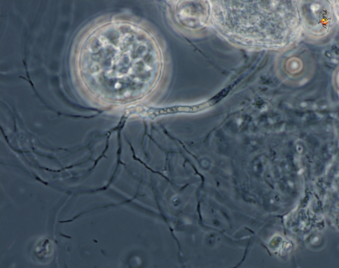
Chytridiomycota - The chytrids
Simple, mostly one-celled organisms
Some are parasitic, and other are saprobic.
Cause of amphibian declines worldwide

Slide 10
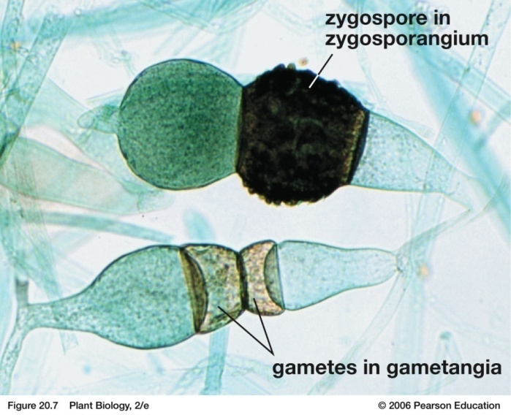
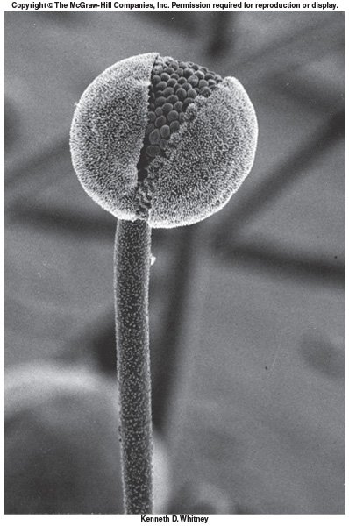
Zygomycota
Sexual reproduction by zygospores
Asexual reproduction by sporangia
A zygomycete sporangium
molds love strawberries

Slide 11
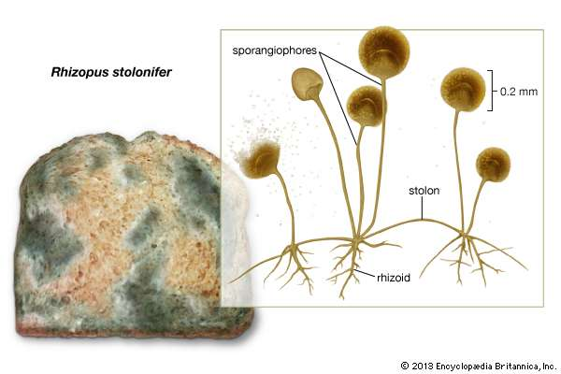
Zygomycota
Some destroy our food like the common Bread Mold
Some are used for food and other things
Tempeh in Indonesia
Manufacture of birth control pills and anesthetics
Yellow pigment for coloring margarine

Slide 12
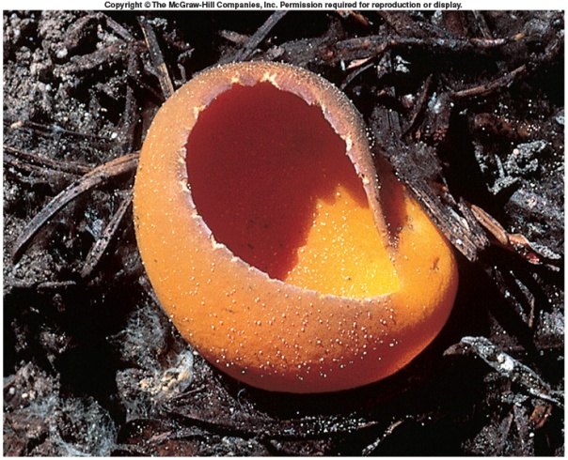
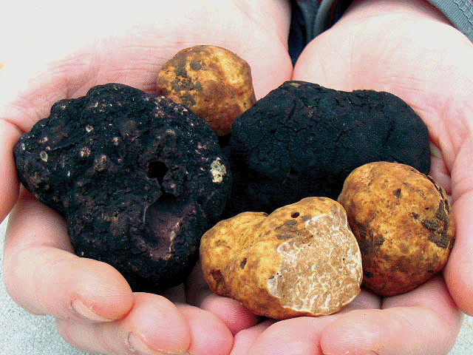
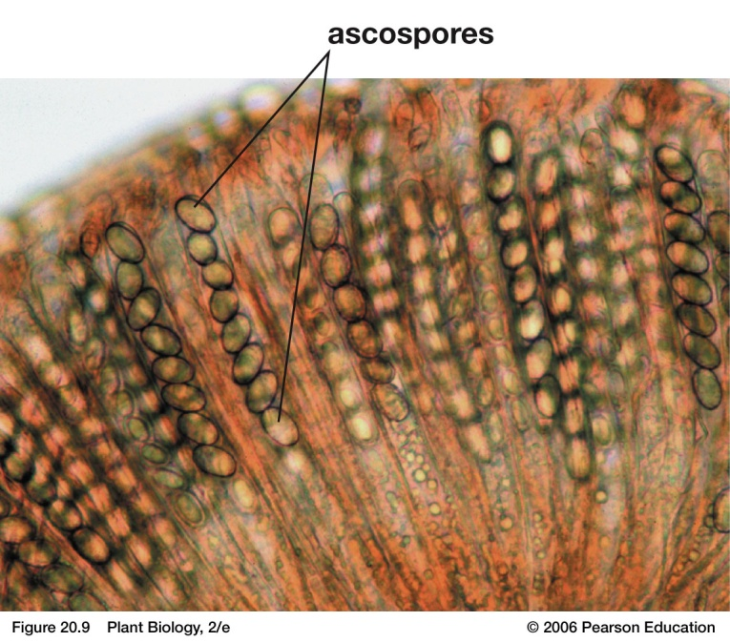
Ascomycota
Food: Morels and truffles
Yeast: Fermentation produces ethyl alcohol - Wines, beers. CO2 causes bread dough to rise and gives it porous texture.
Ascoma
Cool article on beer brewing yeast

Slide 13
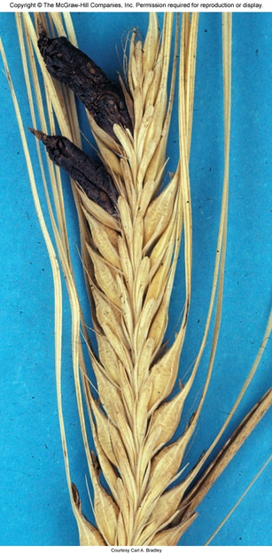
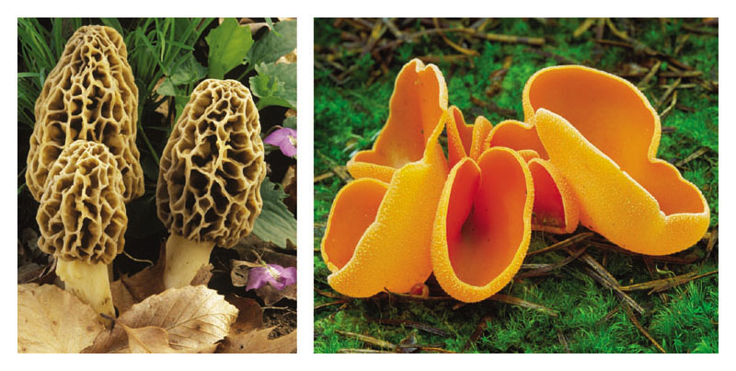
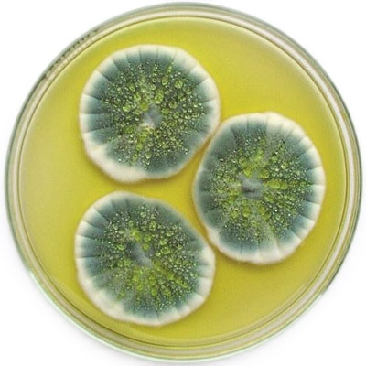
Ascomycota
Penicillium, Aspergillus, Saccharomyces, Morchella
Ergot fungus may infect rye and other grains. Initial source for the manufacture of LSD
Plant diseases - Dutch elm disease, chestnut blight

Slide 14
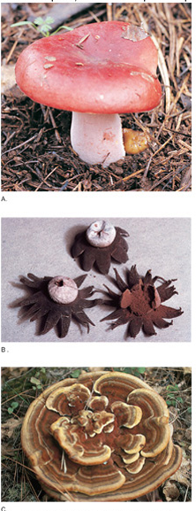
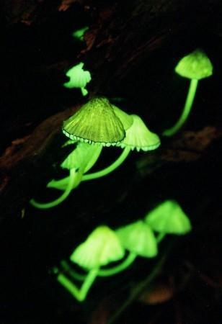
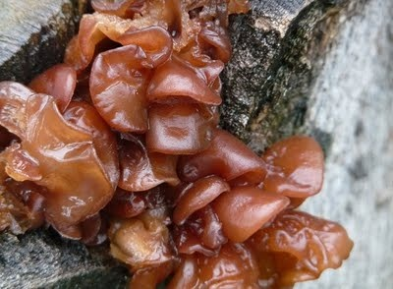
Basidiomycota
Includes mushrooms, toadstools, puffballs, shelf fungi, jelly fungi

Slide 15
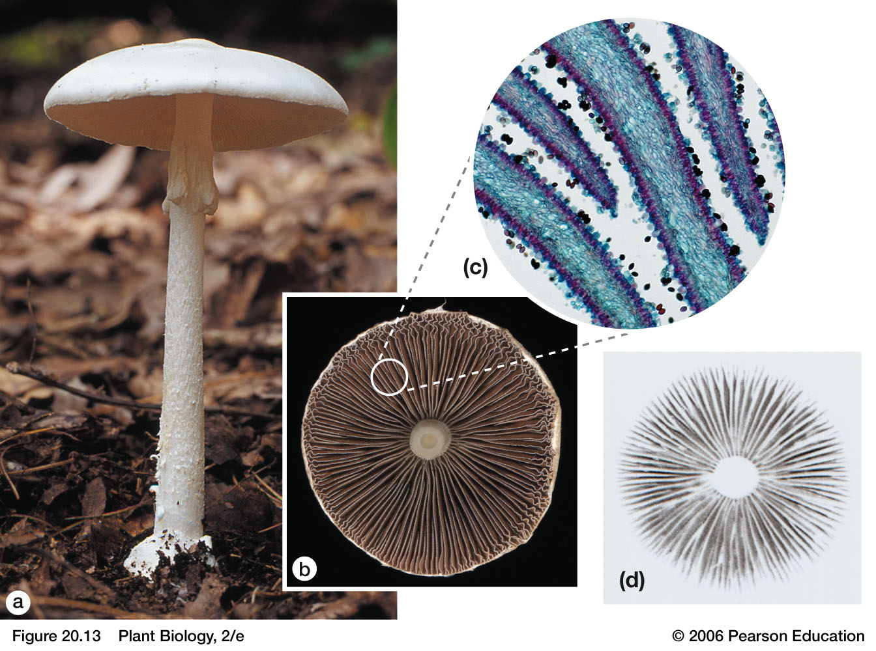
Fruiting Bodies

Slide 16
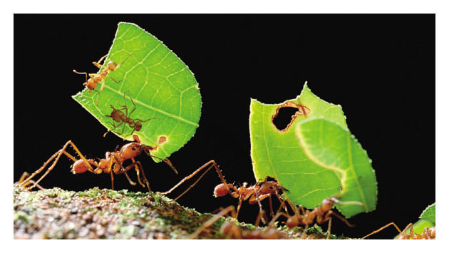
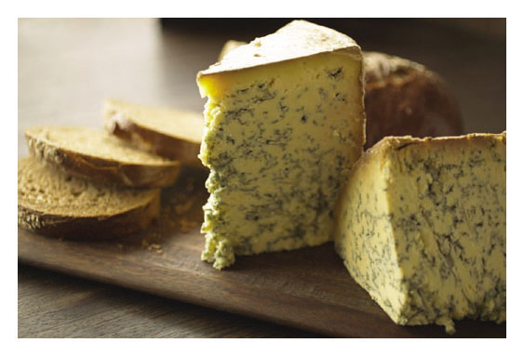
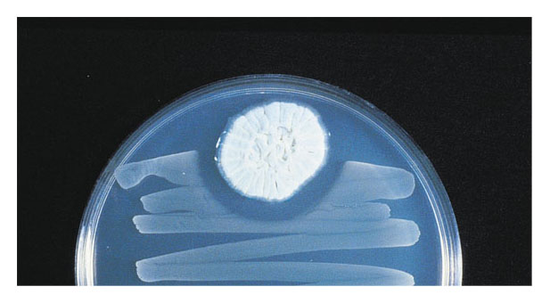
The Importance of Fungi
Fungi also form mutualistic relationships with animals
Fungi have enormous ecological benefits and practical uses- essential decomposers & provide antibiotics and food
Staphylococcus
aureus
Penicillium
Zone of
inhibited
growth

Slide 17
Symbiosis
When two species live together and at least one of them is dependent on the relationship to survive
There are three basic types of symbiosis
Mutualistic: When both parties benefit
Parasitic: When one party benefits and the other is harmed
Commensalistic: When one party benefits and the other is neither helped nor harmed.
There are fungal examples of all three

Slide 18
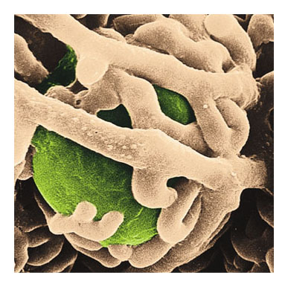
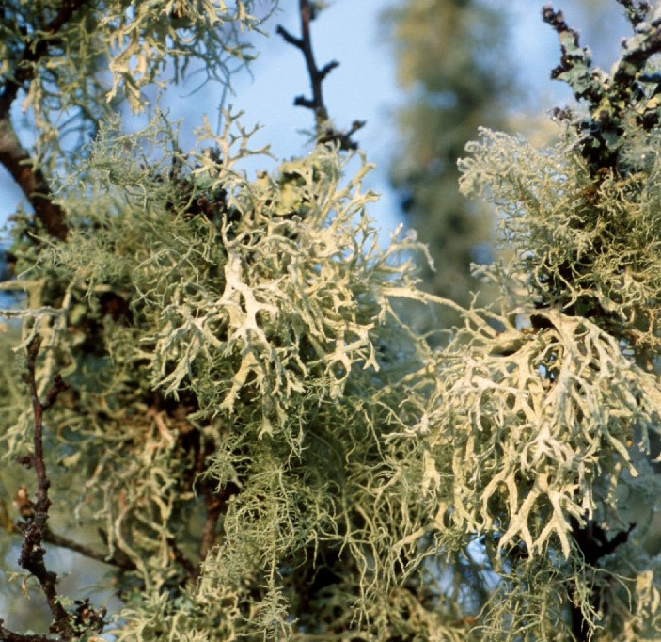
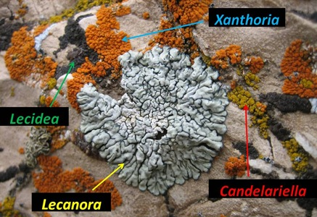
Lichens: Mutualism
Lichens consist of fungi living mutualistically with photosynthetic organisms (algae or cyanobacteria
Fungal
hyphae
Algal
cell
Colorized SEM 1,000 ×

Slide 19
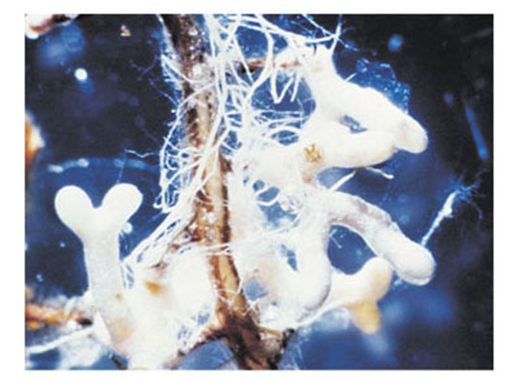
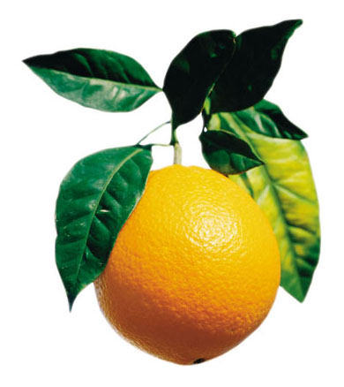
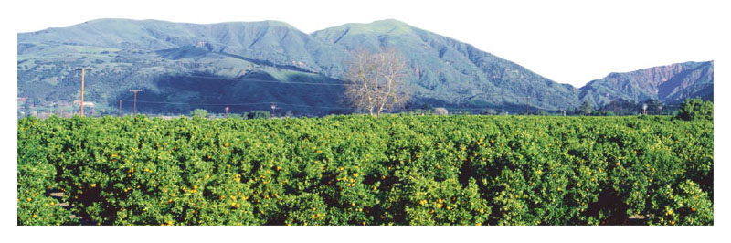
Mycorrhizae: Mutualism
Fungi form mutualistic relationships with plants
This benefits farms and ecological restoration projects

Slide 20
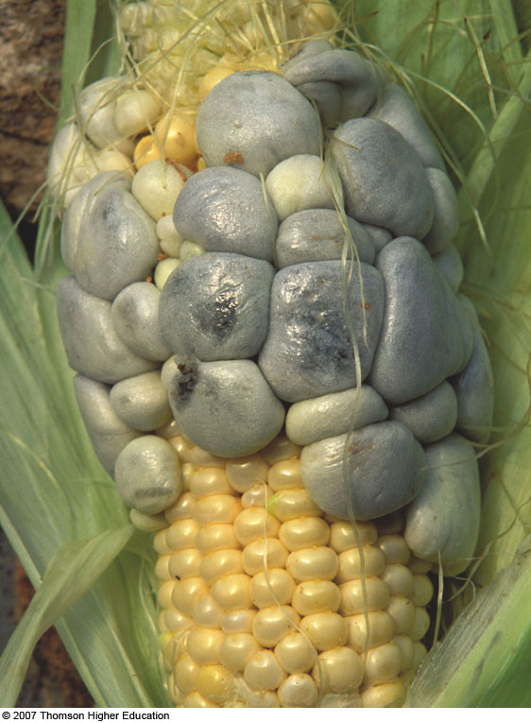
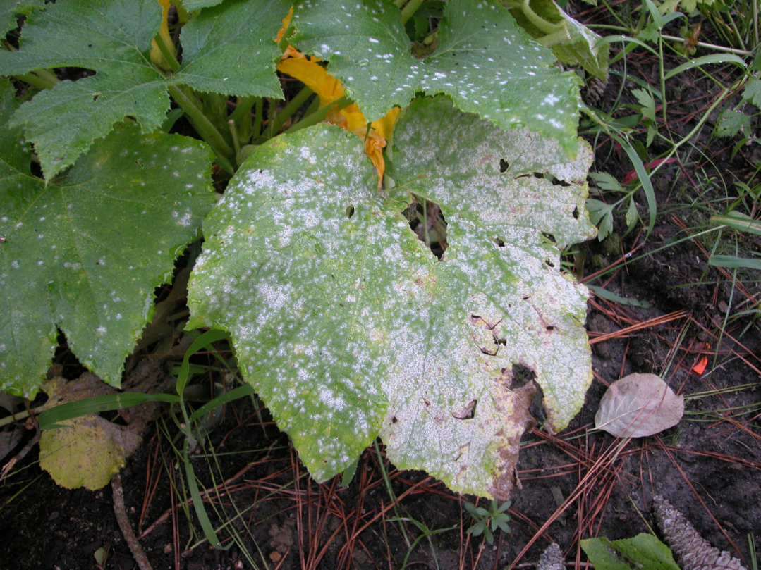
Fungal pathogens: Parasitism
Smuts
Rusts
Mildews
Huitlacoche

Slide 21
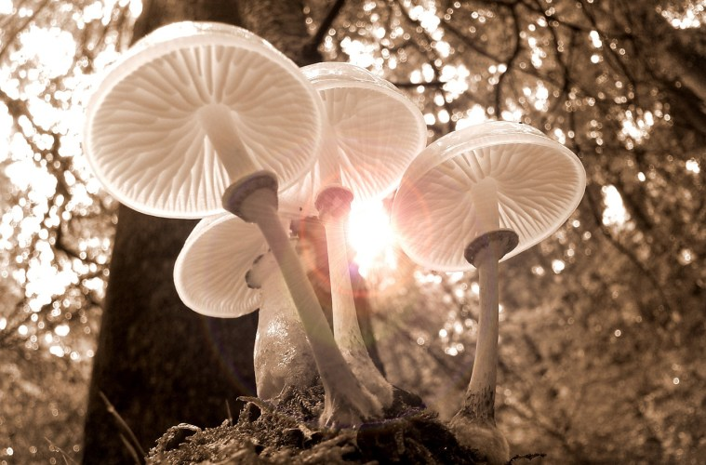
Fungi are amazing
Mother Trees
Attenborough on Fungi
Fantastic Fungi

Slide 22
The Diversity of Organisms on this Planet are divided into different Domains

Slide 23
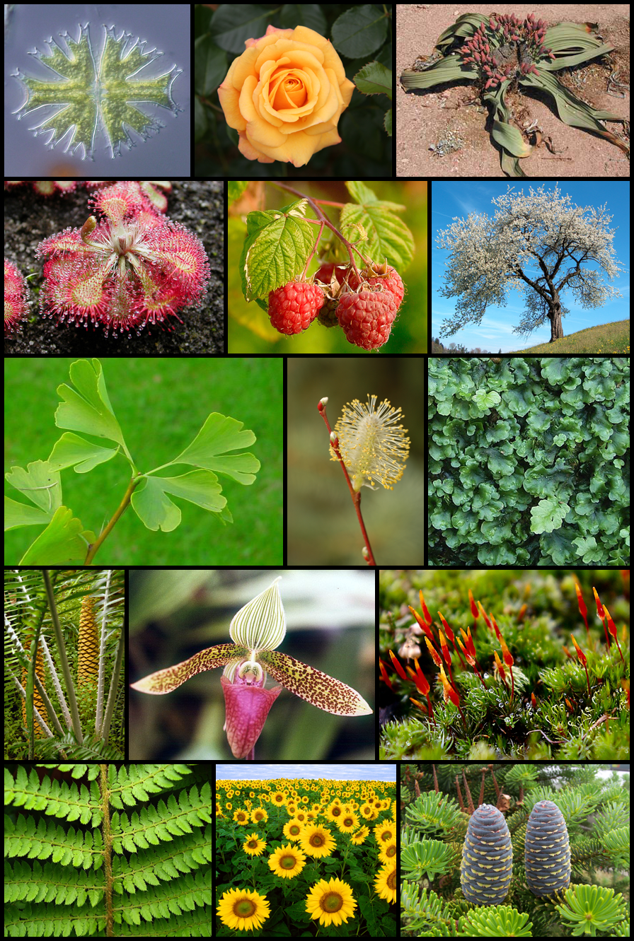
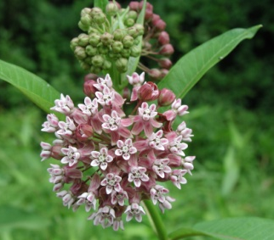
Characteristics of Kingdom Plantae
Cell walls containing cellulose
Autotrophic
Chloroplasts with chlorophyll a and b
Multicellular
Cuticle & stomata
Non-mobile
Alternation of Generations

Slide 24
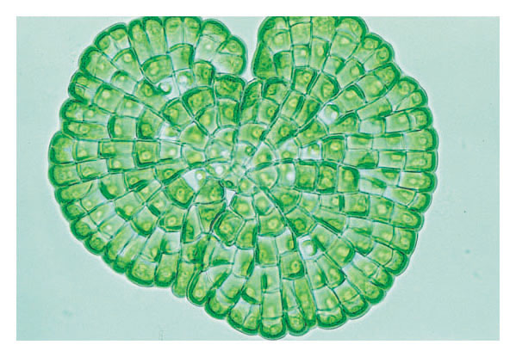
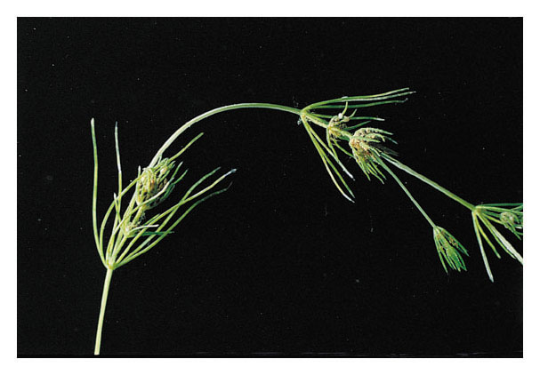
Kingdom Plantae
Plants evolved from green algae
Molecular, physical, and chemical evidence indicate that green algae called charophyceans are the closest living relatives of plants

Slide 25
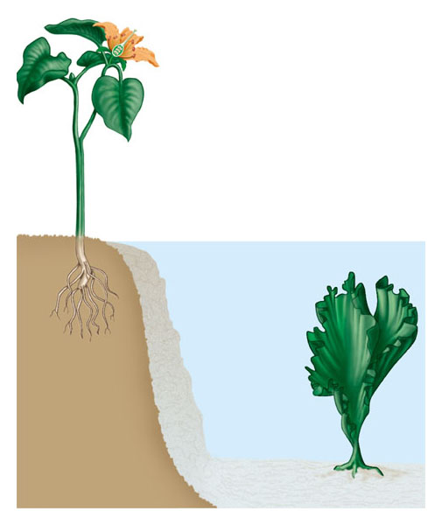
Kingdom Plantae
Plants have some specific adaptations that are not found in algae
Plant
Reproductive structures, as in flowers, contain spores and gametes
Leaf performs photosynthesis
Cuticle covering leaves and stems reduces water loss; stomata in leaves allow gas exchange
Stem supports plant and may perform photosynthesis
Surrounding water supports alga
Alga
Whole alga performs photosynthesis; absorbs water, CO₂, and minerals from the water
Roots anchor plant; absorb water and minerals from the soil
Holdfast anchors alga

Slide 26
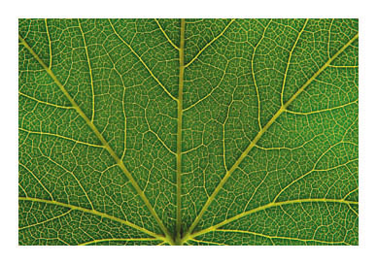
Kingdom Plantae
Plants have vascular tissue
Which helps distribute nutrients throughout the organism

Slide 27
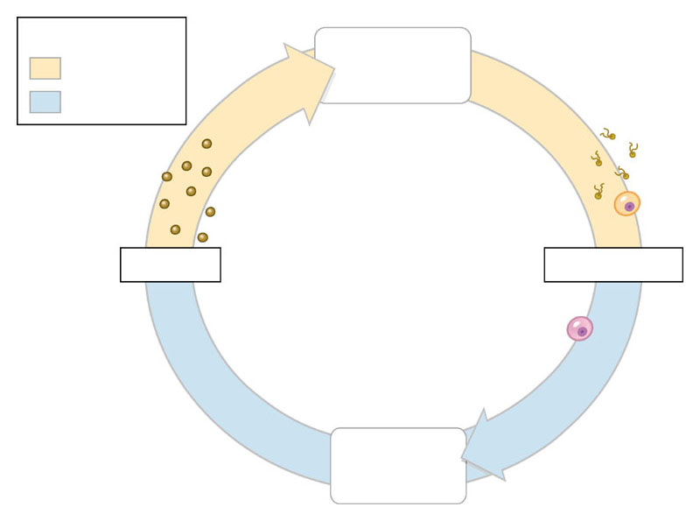
Kingdom Plantae
Plants alternate between 2 generations in their life cycle: Alternation of generations
Key
Gametophyte plant (n)
Haploid (n)
Diploid (2n)
Mitosis
Mitosis
Sperm
Spores (n)
Egg
Gametes (n)
Meiosis
Fertilization
Zygote (2n)
Mitosis
Sporophyte plant (2n)

Slide 28
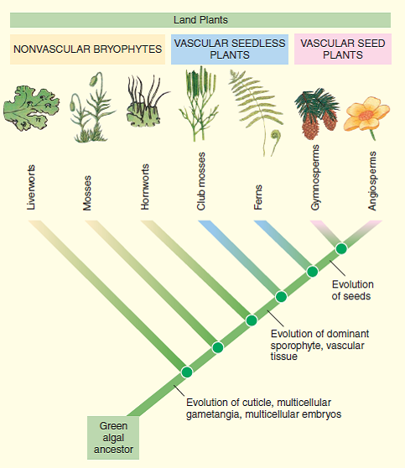
Kingdom Plantae
Plant diversity reflects the evolutionary history

Slide 29
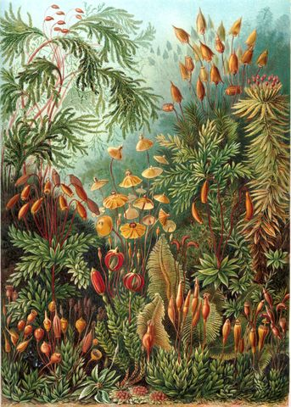
Kingdom Plantae
Bryophytes

Slide 30
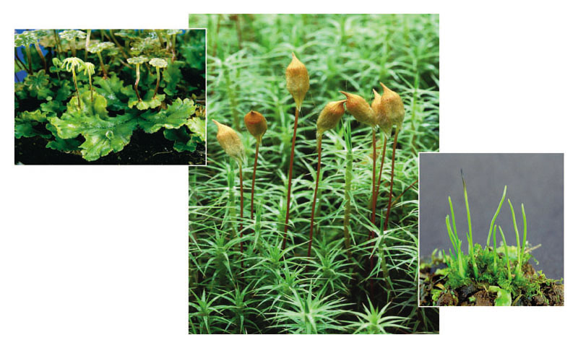
Kingdom Plantae, Phylum Bryophyta
Bryophytes lack vascular tissue and include
The mosses, hornworts, and liverworts

Slide 31
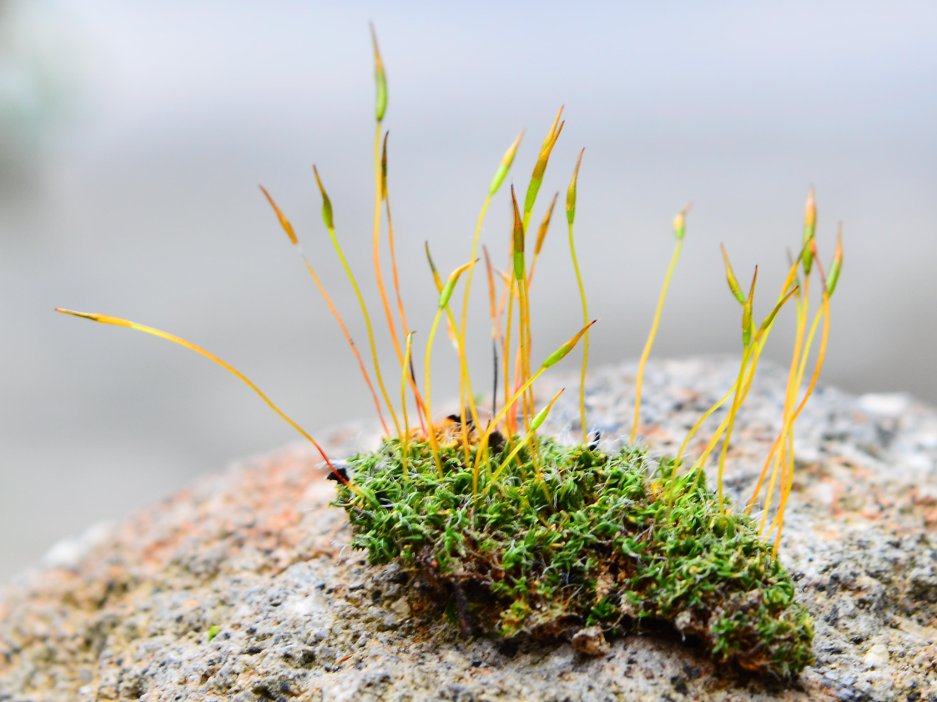
Kingdom Plantae, Phylum Bryophyta
Mosses have a dominant gametophyte
Which produce eggs and swimming sperm
The zygote develops on the gametophyte into the smaller sporophyte

Slide 32
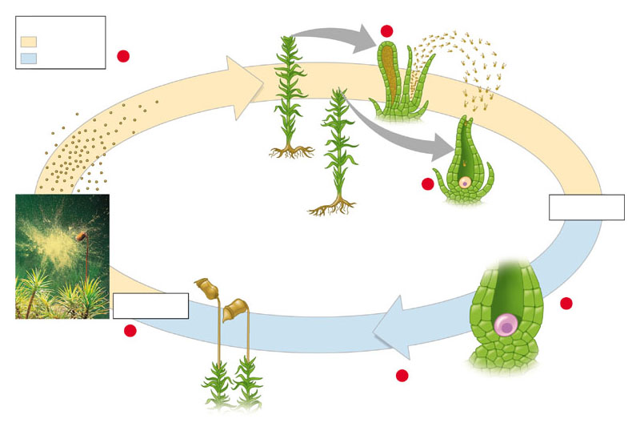
Kingdom Plantae, Phylum Bryophyta
Mosses follow the alternation of generations
Key
Gametophytes (n)
Haploid (n)
1
Male
Diploid (2n)
5
Mitosis and development
Sperm (n) (released from gametangium)
Spores (n)
Female
1
Egg (n)
Fertilization
Sporangium
Stalk
Sporophytes (growing from gametophytes)
Meiosis
2
Sporophyte (2n)
Zygote (2n)
4
3
Mitosis and development
Second animation of Moss life cycle
Liverwort life cycle
Moss life cycle

Slide 33
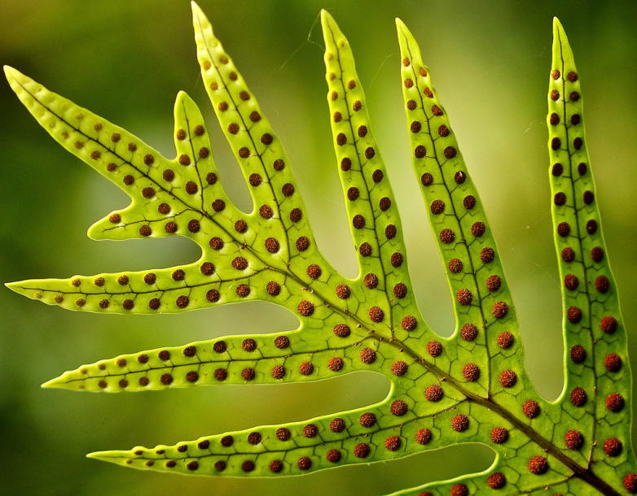
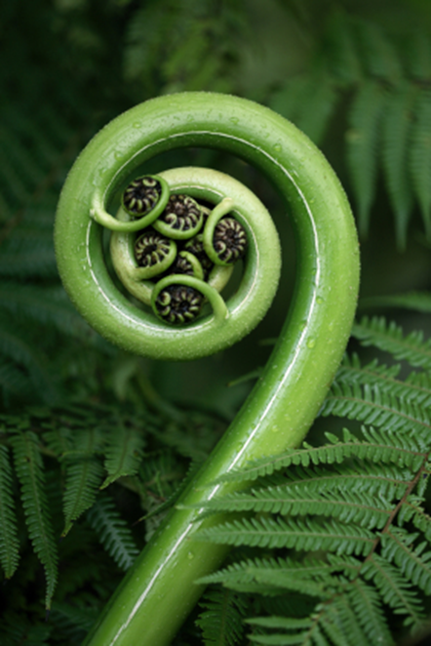
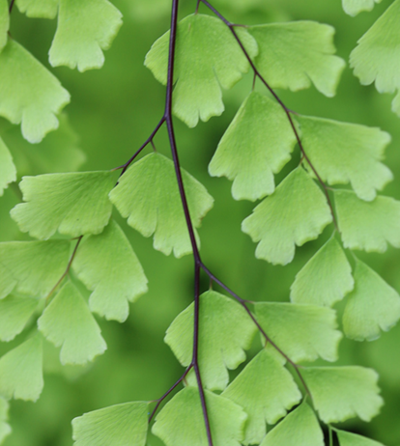

Kingdom Plantae, Phylum Monilophyta
Ferns are seedless vascular plants
Are sporophyte dominant
disperse with spores from sori
and have flagellated sperm

Slide 34

Kingdom Plantae, Phylum Monilophyta
Seedless plants dominated vast “coal forests”
Ferns and other seedless plants once dominated ancient forests
Their remains formed coal

Slide 35




Ferns come in a variety of shapes and sizes

Slide 36

Kingdom Plantae, Phylum Monilophyta
Ferns follow an alternation of generations
Key
1
Haploid (n)
Sperm (n) (released from male gametangium)
Diploid (2n)
5
Mitosis and development
Gametophyte (n) (underside)
Female
gametangium (n)
Spores (n)
Egg (n)
Meiosis
Fertilization
Clusters of sporangia
4
2
New sporophyte (2n) growing out of gametophyte
Zygote (2n)
3
Mitosis and development
Mature sporophyte (independent of gametophyte)

Slide 37


Kingdom Plantae, Phylum Pinophyta
Gymnosperms, such as pines and cycads
Are sporophyte dominant
Produce seeds in cones
Produce pollen in cones
Wind moves pollen from plant to plant at which point the pollen produces a sperm= pollination
Produce woody tissues

Slide 38

Kingdom Plantae, Phylum Pinophyta

Slide 39

Kingdom Plantae, Phylum Pinophyta
Pines follow an alternation of generations
4
A haploid spore cell in ovule develops into female gametophyte, which makes eggs.
Scale
1
Female cone bears ovules.
Ovule
Meiosis
Female gametophyte (n)
Sporangium (2n)
5
Male gametophyte (pollen) grows tube to egg and makes and releases sperm.
Spore mother cell (2n)
Pollen grains (male gametophytes) (n)
Integument
Eggs (n)
3
Pollination
Sperm (n)
Male gametophyte (pollen grain)
Fertilization
Meiosis
2
Sporangia in male cone produce spores by meiosis; spores develop into pollen grains.
Mature sporophyte
Seed coat
Embryo (2n)
Zygote (2n)
Food supply
6
Zygote develops into embryo, and ovule becomes seed.
Key
Seed germinates, and embryo grows into seedling.
Haploid (n)
7
Diploid (2n)
Seed

Slide 40




Kingdom Plantae, Other Gymnosperms
Pinophyta – Pines, etc.
Ginkgophyta-Ginkgo
Cycadophyta- Cycads
Gnetophyta- Ephedra, Welwischia

Slide 41



Kingdom Plantae, Phylum Magnoliophyta
Also known as Angiosperms
Sporophyte dominant
Produce seeds in an ovary that becomes a fruit
Produce pollen in an anther of a flower
Animals move pollen from flower to flower at which point the pollen produces a sperm = pollination

Slide 42


Kingdom Plantae, Phylum Magnoliophyta
The flower is the centerpiece of reproduction
Flowers usually consist of sepals, petals, stamens (which produce pollen), and ovaries inside of which ovules (which produce eggs)
Stigma
Anther
Style
Pistil
Stamen
Ovary
Filament
Petal
Sepal
Receptacle
Ovule

Slide 43



Kingdom Plantae, Phylum Magnoliophyta
The seeds of angiosperms develop within protective ovaries that become fruits

Slide 44

Kingdom Plantae, Phylum Magnoliophyta
Flowering plants follow an alternation of generations

Slide 45




Kingdom Plantae, Phylum Magnoliophyta
Ovaries become fruits
Ovules become seeds inside fruits

Slide 46




Kingdom Plantae, Phylum Magnoliophyta
The structure of a fruit reflects its function in seed dispersal

Slide 47

Plants are important in many ways
Some plants in forests can be used in medicinal ways

